Slide 1

Software Architecture
SSE USTC Qing Ding
dingqing@ustc.edu.cn
http://staff.ustc.edu.cn/~dingqing

Slide 2

Quality Attributes of Architecture IV
Testability & Usability

Slide 3
Agenda
Testability & Usability
  Source of stimulus
  Stimulus
  Environment
  Artifact
  Response
  Response measure
  Tactics

Slide 4
TESTABILITY
Software testability refers to
  the ease with which software can be made to demonstrate its faults through (typically execution-­‐based) testing.
For a system to be properly testable,
  it must be possible to control each component's internal state and inputs and then to observe its outputs.

Slide 5
TESTABILITY
Testing
  is done by various developers, testers, verifiers, or users and
  is the last step of various parts of the software life cycle.
Portions of the code, the design, or the complete system may be tested.
The response measures for testability deal with
  how effective the tests are in discovering faults and
  how long it takes to perform the tests to some desired level of coverage.

Slide 6
TESTABILITY
Source of stimulus.
  The testing is performed by unit testers, integration testers, system testers, or the client. A test of the design may be performed by other developers or by an external group.
Stimulus.
  The stimulus for the testing is that a milestone in the development process is met.
Artifact.
  A design, a piece of code, or the whole system is the artifact being tested.
Environment.
  The test can happen at design time, at development time, at compile time, or at deployment time.

Slide 7
TESTABILITY
Response.
  Since testability is related to observability and controllability,
  the desired response is that the system can be controlled to perform the desired tests and
  that the response to each test can be observed.
Response measure.
  Response measures are the percentage of statements that have been executed in some test, the length of the longest test chain (a measure of the difOiculty of performing the tests), and estimates of the probability of Oinding additional faults.

Slide 8
TESTABILITY
Portion of Scenario Source
Possible Values Unit developer
Increment integrator
System verifier
Client acceptance tester System user
Analysis, architecture, design, class, subsystem integration completed; system delivered
Piece of design, piece of code, complete application
At design time, at development time, at compile time, at deployment time
Provides access to state values; provides computed values; prepares test environment
Percent executable statements executed Probability of failure if fault exists Time to perform tests
Length of longest dependency chain in a test
Length of time to prepare test environment
Stimulus
Artifact Environment
Response
Response Measure

Slide 9
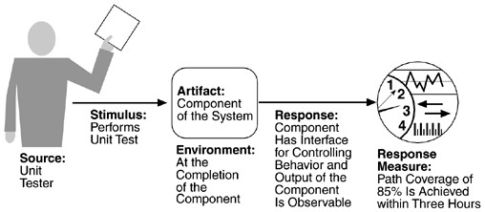
TESTABILITY

Slide 10
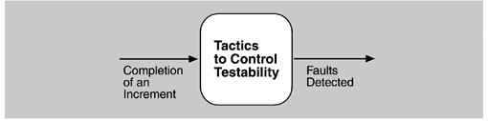
Testability Tactics
The goal of tactics for testability is to allow for easier testing when an increment of software development is completed.
Architectural techniques for enhancing the software testability have not received as much attention as more mature fields such as modifiability, performance, and availability,
– but, since testing consumes such a high percentage of system development cost, anything the architect can do to reduce this cost will yield a signiOicant beneOit.
Goal of testability tactics

Slide 11
Testability Tactics
Although we included design reviews as a testing technique, we are concerned only with testing a running system.
  The goal of a testing regimen is to discover faults. This requires that input be provided to the software being tested and that the output be captured.
Executing the test procedures requires some software to provide input to the software being tested and to capture the output.
  This is called a test harness.
  A question we do not consider here is the design and generation of the test harness. In some systems, this takes substantial time and expense.
We discuss two categories of tactics for testing:
  providing input and capturing output, and
  internal monitoring.

Slide 12
Testability Tactics-INPUT/OUTPUT
There are three tactics for managing input and output for testing.
  Record/playback.
    Record/playback refers to both capturing information crossing an interface and using it as input into the test harness.
  Separate interface from implementation.
    Separating the interface from the implementation allows substitution of implementations for various testing purposes.
  Specialize access routes/interfaces.
    Having specialized testing interfaces allows the capturing or speciOication of variable values for a component through a test harness as well as independently from its normal execution.

Slide 13
Testability Tactics-internal monitoring
A component can implement tactics based on internal state to support the testing process.
  Built-­‐in monitors.
  The component can maintain state, performance load, capacity, security, or other information accessible through an interface.

Slide 14
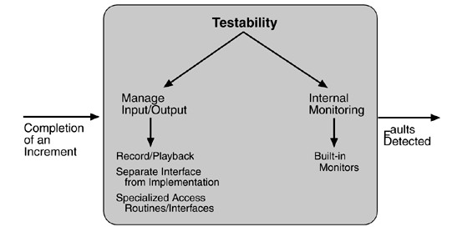
Testability Tactics-Summary

Slide 15
USABILITY
Usability is concerned with
  how easy it is for the user to accomplish a desired task and the kind of user support the system provides.
It can be broken down into the following areas:
  Learning system features.
  Using a system efficiently.
  Minimizing the impact of errors.
  Adapting the system to user needs.
  Increasing confidence and satisfaction.

Slide 16
USABILITY
The normal development process detects usability problems through building prototypes and user testing.
The later a problem is discovered and the deeper into the architecture its repair must be made, the more the repair is threatened by time and budget pressures.

Slide 17
USABILITY
Source of stimulus.
  The end user is always the source of the stimulus.
Stimulus.
  The stimulus is that the end user wishes to use a system efOiciently, learn to use the system, minimize the impact of errors, adapt the system, or feel comfortable with the system.
Artifact.
  The artifact is always the system.
Environment.
  The user actions with which usability is concerned always occur at runtime or at system conOiguration time.

Slide 18
USABILITY
Response.
  The system should either provide the user with the features needed or anticipate the user's needs.
Response measure.
  The response is measured by
    task time,
    number of errors,
    number of problems solved,
    user satisfaction,
    gain of user knowledge,
    ratio of successful operations to total operations,
    or amount of time/data lost when an error occurs.

Slide 19
USABILITY
Portion of Scenario Source
Stimulus
Possible Values End user Wants to
learn system features; use system efficiently; minimize
impact of errors; adapt system; feel comfortable
System
At runtime or configure time
Artifact Environment

Slide 20
USABILITY
Response
System provides one or more of the following responses: to support "learn system features"
help system is sensitive to context; interface is familiar to user; interface is usable in an
unfamiliar context
to support "use system efficiently":
aggregation of data and/or commands; re-use of already entered data and/or commands; support for efficient navigation within a screen; distinct views with consistent operations; comprehensive searching; multiple simultaneous activities
to "minimize impact of errors":
undo, cancel, recover from system failure, recognize and correct user error, retrieve forgotten password, verify system resources
to "adapt system":
customizability; internationalization to "feel comfortable":
display system state; work at the user's pace

Slide 21
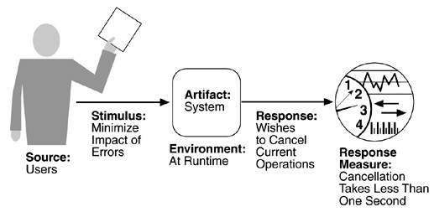
USABILITY
Response Measure
Task time, number of errors, number of problems solved, user satisfaction, gain of user knowledge, ratio of successful operations to total operations, amount of time/data lost

Slide 22
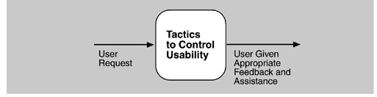
Usability Tactics
Usability is concerned with
  how easy it is for the user to accomplish a desired task and the kind of support the system provides to the user.
Two types of tactics support usability, each intended for two categories “users”.
  The Oirst category, Runtime, includes those that support the user during system execution.
  The second category is based on the iterative nature of user interface design and supports the interface developer at design time. It is strongly related to the modiOiability tactics already presented.
Goal of runtime usability tactics

Slide 23
Usability Tactics-Runtime tactics
Once a system is executing, usability is enhanced
  by giving the user feedback as to what the system is doing and
  by providing the user with the ability to issue usability-­‐based commands such as those we saw
  For example, cancel, undo, aggregate, and show multiple views support the user in either error correction or more efOicient operations.
  Maintain a model of the task.
  In this case, the model maintained is that of the task.
  The task model is used to determine context so the system can have some idea of what the user is attempting and provide various kinds of assistance.
  For example, knowing that sentences usually start with capital letters would allow an application to correct a lower-­‐case letter in that position.

Slide 24
Usability Tactics-Runtime tactics
Maintain a model of the user.
In this case, the model maintained is of the user.
It determines the user's knowledge of the system, the user's behavior in terms of expected response time, and other aspects specific to a user or a class of users.
For example, maintaining a user model allows the system to pace scrolling so that pages do not fly past faster than they can be read.
Maintain a model of the system.
In this case, the model maintained is that of the system.
It determines the expected system behavior so that appropriate feedback can be given to the user.
The system model predicts items such as the time needed to complete current activity.

Slide 25
Usability Tactics- design time tactics
User interfaces are typically revised frequently during the testing process.
  That is, the usability engineer will give the developers revisions to the current user interface design and the developers will implement them.
This leads to a tactic that is a refinement of the modifiability tactic of semantic coherence:
  Separate the user interface from the rest of the application. Localizing expected changes is the rationale for semantic coherence
  The software architecture patterns developed to implement this tactic and to support the modification of the user interface are:
    Model-­‐View-­‐Controller
    Presentation-­‐Abstraction-­‐Control
    Seeheim
    Arch/Slinky

Slide 26
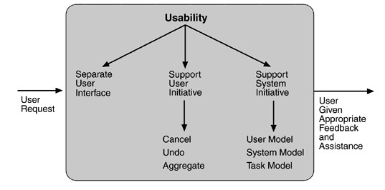
Usability Tactics-Summary

Slide 27
Quality Attribute Stimuli
Availability
Unexpected event, nonoccurrence of expected event
Request to add/delete/change/vary functionality, platorm, quality atribute, or capacity
Periodic, stochastic, or sporadic
Tries to display, modify, change/delete information, access, or reduce availability to system services
Completion of phase of system development
Wants to learn system features, use a system eﬃciently, minimize the impact of errors, adapt the system, feel comfortable
Modiﬁability
Performance Security
Testability Usability

Slide 28
Other System Quality Attributes
We have discussed the quality attributes in a general fashion.
A number of other attributes can be found in the attribute taxonomies in the research literature and
  in standard software engineering textbooks, and we have captured many of these in our scenarios.
For example, scalability is often an important attribute,
  but in our discussion here scalability is captured by modifying system capacity—the number of users supported.
  Portability is captured as a platform modification.

Slide 29
Other System Quality Attributes
If some quality attribute—say interoperability—is important to your organization,
  it is reasonable to create your own general scenario for it.
This simply involves filling out the six parts of the scenario generation framework:
  source, stimulus, environment, artifact, response, and response measure.
For interoperability,
  a stimulus might be a request to interoperate with another system,
  a response might be a new interface or set of interfaces for the interoperation, and
  a response measure might be the difOiculty in terms of time, the number of interfaces to be modified, and so forth.

Slide 30
Business Qualities
In addition to the qualities that apply directly to a system, a number of business quality goals frequently shape a system's architecture.
These goals center on cost, schedule, market, and marketing considerations.
  Time to market.
    If there is competitive pressure or a short window of opportunity for a system or product, development time becomes important.
  Cost and benefit.
    The development effort will naturally have a budget that must not be exceeded.
  Projected lifetime of the system.
    If the system is intended to have a long lifetime, modiOiability, scalability, and portability become important.

Slide 31
Business Qualities
Targeted market.
  For general-­‐purpose (mass-­‐market) software, the platforms on which a system runs as well as its feature set will determine the size of the potential market.
Rollout schedule.
  If a product is to be introduced as base functionality with many features released later, the flexibility and customizability of the architecture are important.
Integration with legacy systems.
  If the new system has to integrate with existing systems, care must be taken to define appropriate integration mechanisms.

Slide 32
Architecture Qualities
Conceptual integrity
  is the underlying theme or vision that unifies the design of the system at all levels.
Correctness and completeness
  are essential for the architecture to allow for all of the system's requirements and runtime resource constraints to be met.
Buildability
  allows the system to be completed by the available team in a timely manner and to be open to certain changes as development progresses.

Slide 33
Relationship of Tactics to Architectural Patterns
In fact,
  an architect usually chooses a pattern or a collection of patterns designed to realize one or more tactics.
  However, each pattern implements multiple tactics, whether desired or not.
The Active Object design pattern decouples method execution from method invocation to enhance concurrency and simplify synchronized access to objects that reside in their own thread of control.

Slide 34
Relationship of Tactics to Architectural Patterns
The pattern consists of six elements:
  a proxy, which provides an interface that allows clients to invoke publicly accessible methods on an active object;
  a method request, which defines an interface for executing the methods of an active object;
  an activation list, which maintains a buffer of pending method requests;
  a scheduler, which decides what method requests to execute next;
  a servant, which defines the behavior and state modeled as an active object;
  and a future, which allows the client to obtain the result of the method invocation.

Slide 35
Relationship of Tactics to Architectural Patterns
The motivation for this pattern is to enhance concurrency—a performance goal.
  Thus, its main purpose is to implement the "introduce concurrency" performance tactic.
Notice the other tactics this pattern involves, however.
  Information hiding (modifiability). Each element chooses the responsibilities it will achieve and hides their achievement behind an interface.
  Intermediary (modifiability). The proxy acts as an intermediary that will buffer changes to the method invocation.
  Binding time (modifiability). The active object pattern assumes that requests for the object arrive at the object at runtime. The binding of the client to the proxy, however, is left open in terms of binding time.
  Scheduling policy (performance). The scheduler implements some scheduling policy.

Slide 36
Relationship of Tactics to Architectural Patterns
Any pattern implements several tactics,
  often concerned with different quality attributes, and any implementation of the pattern also makes choices about tactics.
  For example, an implementation could maintain a log of requests to the active object for supporting recovery, maintaining an audit trail, or supporting testability.
The analysis process for the architect involves
  understanding all of the tactics embedded in an implementation,
and the design process involves
  making a judicious choice of what combination of tactics will achieve the system's desired goals.

Slide 37
Project
Suppose you needs to improve the testability & usability of your SNS website. Please describe your design from the following aspects:
  How do you want to apply the tactics of Special Access Interface and Plugin into your SNS website to improve its testability? Please give your detail analysis.
  Give two examples to respectively explain why usability is related to both architecture and detail design.

